Slide 1
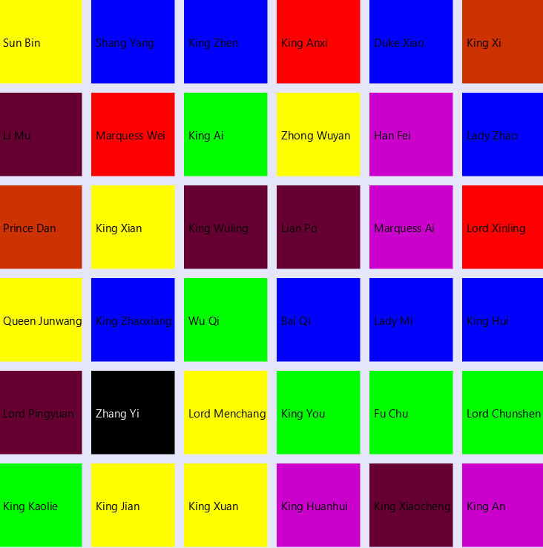
Warring States Game Assignment 2
Ruiyi Sun U6233314
Shunyu Yao U6252997
Akshat Singhal U6322388

Slide 2
Summary
Basic outline
Problems
Design Approach
Working

Slide 3
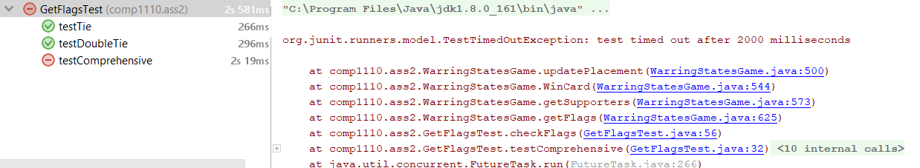
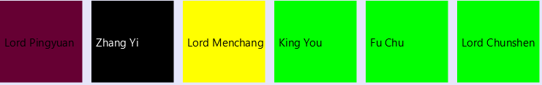
Problems
Task 8 (Timeout)
Test timed out after 2000ms
2. Viewer (Task 4)
Changing the colour of
the text to white

Slide 4
Design Approach
Designing a basic game
Managing the tasks

Slide 5

Screenshots of the GAME

Slide 6
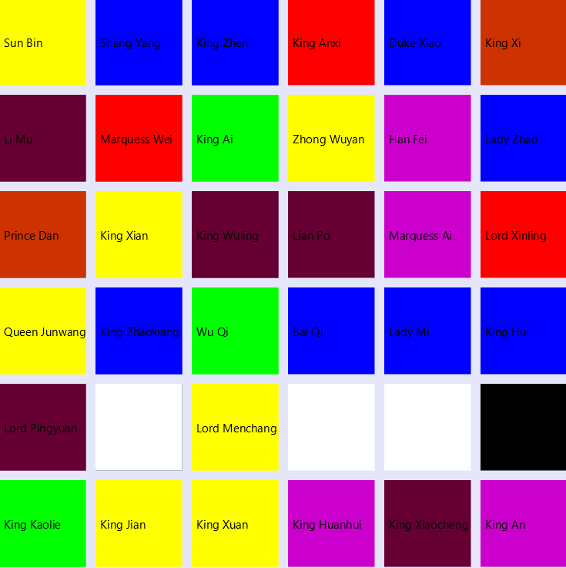

Slide 7
Interesting Aspects
Simple working of the game
Making the kingdoms without using the assets

Slide 8
Questions?

